Slide 1
Structure of a DBMS
These layers
must consider
concurrency
control and
recovery
A typical DBMS has a layered architecture
The figure does not show the concurrency control and recovery components
This is one of several possible architectures; each system has its own variations
Query Parser
Query Optimization
and Execution
Relational Operators
Files and Access Methods
Buffer Management
Disk Space Management
6-layer model
DB

Slide 2
Data Storage
DBMS deals with a very large amount of data
How does a computer system store and manage very large volumes of data?
What representations and data structures best support efficient manipulations of this data?

Slide 3
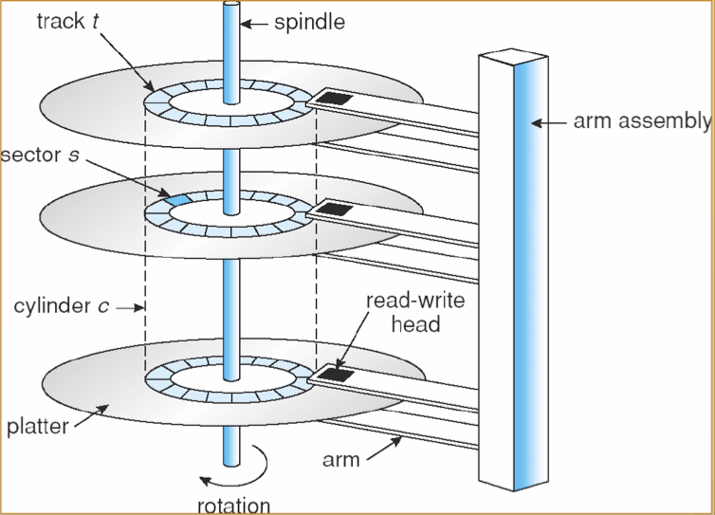
Storage Hierarchy
CPU
CACHE
KB/MB
MAIN MEMORY
MB/GB
cylinder:track:sector
Access time
Seek time
Rotation time
Transfer time
Performance improvement does not match
Microprocessors: 50% or more
Disk access times: 10%
Disk transfer rates: 20%
About 200 times slower than DRAM
HARD DISK (RAID) / SSD
GB/TB
OPTICAL DISK
GB/TB
TAPE
TB

Slide 4
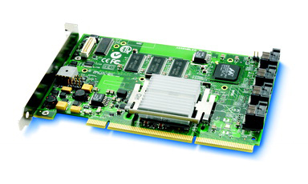
Redundant Array Independent Disk (RAID)
Hard drive is mechanical
It is slow, and in particular, easy to fail
RAID: A number of disks is organized and appears to be a single one to the OS
Aggregate disk capacity
Increase I/O throughput through data striping
Improve reliability through redundancy
Everything in RAID is usually redundant
Power supplies, fans, temperature sensors
Controllers
Some well-known configurations
RAID 0: striping, no mirroring or parity
RAID 1: mirroring
RAID 2: bit-level striping with parity coding
RAID 3: block-level striping with distributed parity coding
….
PC
RAID System

Slide 5
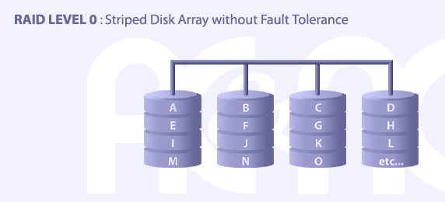
RAID - Level 0
RAID 0 implements a striped disk array, the data is broken down into blocks and each block is written to a separate disk drive
PRO: I/O performance is greatly improved by spreading the I/O load across many channels and drives
CON: NOT fault-tolerant
Applications: video editing, etc. (requiring high speed)

Slide 6
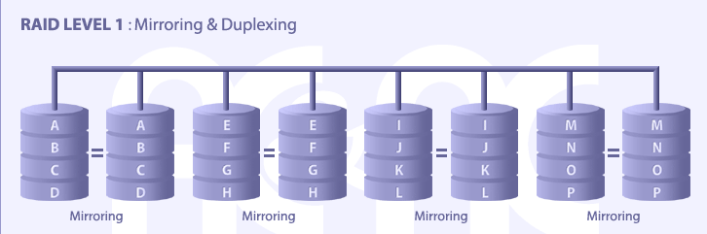
RAID - Level 1
RAID 1: Each data item is duplicated on two disks (mirror)
PRO: 1W/2R possible per mirrored pair, sustain simultaneous disk failures
CON: inefficient -- 100% overhead of disk space
Applications: accounting, etc. (mission critical)

Slide 7
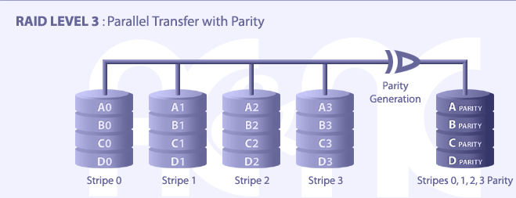
RAID - Level 3
RAID 3: Each data block is subdivided ("striped") and written on the data disks. Stripe parity is generated on Writes, recorded on the parity disk and checked on Reads.
PRO: high R/W rate, Disk failure has an insignificant impact on throughput, low ratio of ECC
CON: Controller design is fairly complex, need on-the-fly disk rebuild in case of drive failures

Slide 8
Storing databases/tables/records
Each database contains a number of tables
Each table contains a number of records
Each record has a unique identifier called a record id, or rid
Records can be stored in files based on the underlying OS
Records can be stored directly to disk blocks bypassing file systems (raw devices)
Why raw devices?
Differences in OS support: portability issues
Some limitations, e.g., files can’t span disks, imagine keep the whole Internet on local drives
Performance, e.g., DBMS can predict access pattern better
Higher Layer
Access Manager
Buffer Manager
Disk Manager
Arrange records in a page, the size of which is usually 4k or 8k
or
OS files
disks
Lowest level in DBMS software architecture

Slide 9
Disk Manager
Physical storages are organized into pages of equal size
There is mapping between page id and its physical location
Given a page id, find its physical location (e.g., disk id + cylinder + sector)
Page management
For each page, remember it is used or free
Allocate/de-allocate a page
Read/write a page
Typical APIs
AllocatePage() / FreePage(pID)
ReadPage(pID) / WritePage(pID, pageContent)
Page management
Page 1
Page 2
:::::
Page m
Mapping between page and physical storages
HD
Optical
Tape
These pages are physically
located in different devices
(RAID, optical, and/or tape)
Notes:
Developer who does this really need to know OS well to support raw devices

Slide 10
Access Manager
Mapping between record id (db:table:rid) and page id
Given a rid, find the id of the page where this record is stored
Db1:T1
Dbi:Tj
Record 1
Record 1
Record 2
Record 2
:::::
::
:::::
Table
Page
Record n1
Record n2
t1
t2
:::
tn
p1
p2
:::
pj
DB
Insert/delete/retrieve a record from/to a page
db1
db2
:::
dbn
Table
R1
Page 1
t1
t2
:::
tm
R2
Page 2
R3
:::::
. .
All these are in pages
Page m
N

Slide 11
Access Manager
Mapping between record id (db:table:rid) and page id
Given a rid, find the id of the page where this record is stored
Record management
Arrange records into a page
Retrieve records from a page
Typical APIs
CreateDB(name)
CreateTable(DB, tName, field[])
ReadRecord(DB, tName, rID)
WriteRecord(DB, tName, rID, r)
DeleteRecord(DB, tName, rID)
Append(DB, tName, record)
Indexing …..
Db1:T1
Dbi:Tj
Record 1
Record 1
Record 2
Record 2
:::::
::
:::::
Record n1
Record n2
Insert/delete/retrieve a record from/to a page
Page 1
Page 2
:::::
Page m

Slide 12
Quick Review
Db1:T1
Dbi:Tj
Record 1
Record 1
Record 2
Record 2
:::::
::
:::::
record-level operations
Record n1
Record n2
Higher Layer
CreateTable(DB, tName, field[])
ReadRecord(DB, tName, rID)
WriteRecord(DB, tName, rID, r)
DeleteRecord(DB, tName, rID)
Append(DB, tName, record)
Access Manager
Mapping between database-table-record and page
Buffer Manager
Disk Manager
Page 1
page-level operations
Page 2
or
:::::
OS files
disks
AllocatePage()
FreePage(pID)
WritePage(pID, page)
ReadPage(pID)
Page m
Mapping between page and physical storages
A user sees storage at record level, he can create/modify/delete a record
Access Manager sees storage at page level, it can allocate/read/write/deallocate a page
Disk Manager sees storage at device level (e.g., disk/cylinder/sector)
HD
Optical
Tape
Notes:
Developer who does this really need to know OS well to support raw devices

Slide 13
Buffer Manager
Page Requests from Higher Levels
BUFFER POOL
disk frame
MAIN MEMORY
free frame
DISK
DB
choice of frame dictated
by replacement policy
Size of a frame equal to size of a disk page
Two variables associated with each frame/page:
Pin_count: number of current users of the page
Dirty: whether the page has been modified since it has been brought into the buffer pool

Slide 14
When a page is requested
If a requested page is not in the buffer pool:
Choose a frame for replacement if the buffer is full
If the frame is dirty, write it to disk
Read the requested page into the chosen frame
Pin the page and return its address to the requester
Pinning: Incrementing a pin_count
Unpinning: Release the page and the pin_count is decremented
Page is chosen for replacement by a replacement policy
Least-recently-used (LRU): based on time of last reference
First-In-First-Out (FIFO): based on time of reading the page in
Last-in-first-out (LIFO): based on time of reading the page
Most-recently-used (MRU): based on time of last reference
etc.

Slide 15
More on Access Manager
Table
Page
How to store a record
Record format
How to arrange records in a page
Page format
How to manages pages for a file
File formats
t1
t2
:::
tn
p1
p2
:::
pj
DB
db1
db2
:::
dbn
Table
R1
t1
t2
:::
tm
R2
R3
. .
N

Slide 16
Record Formats
Fixed length
Field types and lengths are stored in system catalogs
Name: char (40), Address: char (100), Phone: char (10), Email: char (100)
F1
F2
F3
F4
Variable length (VARCHAR, BLOB-binary large object, etc.)
Two alternative formats (number of fields is fixed)
4
F1
$
F2
$
F3
$
F4
$
Field
Count
Fields Delimited by Special Symbols
F1 F2 F3 F4
Directory
Array of Field Offsets
Notes:
Which one do you prefer? In terms of searching complexity
How many bits are needed for each pointer? Why we want to minimize this cost?
At this level, we need supper super efficient solutions!

Slide 17
Page Formats: Fixed Length Records
Manage records within a page
Partition a page into a number of slots, each holding one record
Record the number of records (total = PageSize/RecordSize)
How to store records among slots?
SOLUTION 1: PACKED
Need a variable N to record the number of slots being used
The free slot starts from N+1
When appending a new record, allocate slot N+1, then N++
When deleting a record at slot i, move the last record to the slot i. If sorted, all records after slot i must be moved up
Slot 1
Slot 2
Slot 3
. . .
Free
Space
Slot N
N
number
of records
Notes:
The cost of insert, find, delete a record? Space cost?

Slide 18
Page Formats: Fixed Length Records
SOLUTION 2: UNPACKED
Need a bitmap to record if a slot is occupied or not
If bit[i]=1, slot i is occupied
When inserting a record, search the bitmap to find a bit that is 0, then allocate the corresponding slot for the record
When deleting a record, simply reset the corresponding bit
Slot 1
Slot 2
Free
Space
. . .
Slot N
Slot M
1
. . .
0
1
1
M
M ... 3 2 1
number
of slots

Slide 19
Page Formats: Variable Length Records
Rid = (i,N)
Page i
Rid = (i,2)
Rid = (i,1)
20
16
24
N
Pointer
to start
of free
space
N . . . 2 1
# slots
SLOT DIRECTORY
Maintain a directory of slots, which is a number of entries
Each record stored in the page occupies one entry, which keep the information of the record, i.e., (record offset, record length)
Implementation issues: bits for pointer, record spanning multiple pages, memory holes created after repeated insert and delete operations

Slide 20
File Formats and Operation Costs
Manage pages within a file/table, different file formats
Heap File: Suitable when typical access is a file scan retrieving all records.
Sorted File: Best if records must be retrieved in some order, or only a `range’ of records is needed.
Hashed File: Good for equality selections.
Cost factors (we ignore CPU costs, for simplicity)
P: The number of data pages
R: Number of records per page
D: (Average) time to read or write disk page
Measuring number of page I/O’s ignores gains of pre-fetching blocks of pages; thus, even I/O cost is only approximated.

Slide 21
Heap Files
The data in a heap file is not ordered.
How to find a page that has some free space
How to find the free space inside a page
Two types of implementations
Link-based
Directory-based

Slide 22
Heap File Implemented as a List
Data
Page
Data
Page
Data
Page
Full Pages
Header
Page
Data
Page
Data
Page
Data
Page
Pages with
Free Space
To insert a record, one searches the pages with free space and find the one that has sufficient space
Many pages may contain some tiny free space
A long list of pages may have to loaded in order to find an appropriate one

Slide 23
Heap File Using a Page Directory
Data
Page 1
Header
Page
Data
Page 2
Data
Page N
DIRECTORY
The directory is a collection of pages
Each page contains a number of entries
Each entry contains a pointer linking to the page and a variable recording the free space
The number of directory pages is much smaller than that of data pages
So the directory pages can be loaded all in main memory
Each entry takes 5 bytes, so the number entries in one header page is PageSize/5 entries, the number of header pages for N data pages is N * 5 / PageSize

Slide 24
Heap Files and Associated Costs
P: The number of data pages
R: Number of records per page
D: (Average) time to read or write disk page
Scan: P*D
Search with equality selection: If a selection is based on a candidate key, on average, we must scan half the file, assuming that the record exists 0.5*P*D.
Search with range selection: The entire file must be scanned. The cost is P*D.
Insert: Assume that records are always inserted at the end of the file. We fetch the last page in the file, add the record, and write the page back. The cost is 2D.
Delete:. The cost also depends on the number of qualifying records. The cost is search cost + D.
Data
Page 1
Data
Page 2
::
directory
Data
Page P

Slide 25
Sorted File
RID
sorted field
Header
Page
Name
age
Format 1
Sort records directly
The records in each page is sorted
Each entry in a header page links to one page, and record the minimum and maximum values in the page
Search
Can be binary on header pages (which can be all loaded in main memory). The cost is 2+.
How about performing directly on the data pages? The cost would be log n+.
Pro: Minimum page header overhead
Con: Expensive when inserting a record
1
Ann
1
1, 23
Data
Page 1
2
Ben
9
3
Col
20
4
Amy
23
Data
Page 2
DIRECTORY
Data
Page N

Slide 26
Sorted File
sorted field
RID
Format 2
Keep the sorted field using index page
Each entry points to a record
May contain the value of the sorted field
May contain a valid bit for deleting operation
The entries are sorted according to the sorted field
Data
Page 1
Index
Page
1
Amy
23
1
9
2
Ben
9
20
3
Col
20
4
Ann
1
4
Data
Page n
DIRECTORY
PRO: Inserting a record just need to reorganize the index page, the size of which is much smaller. We can sort another attribute (e.g., name).
CON: For each record, one entry is needed in index page, so the size of index page is much larger than that in “Format 1”. The index pages may not be loaded in memory memory, but we can build another layer (header pages)

Slide 27
Sorted Files and Associated Costs
Scan: P * D
Search with equality selection: Assume that the selection is specified on the field by which the file is sorted. The cost is D * log P, assuming that the sorted file is stored sequentially.
Search with range selection:
Insert: Search cost + 2*0.5*P*D; the assumption is that the inserted record belongs in the middle of the file.
Delete: Search cost + 2*0.5*P*D; the assumption is that we need to pack the file and the record to be deleted is in the middle of the file.
D * log P + cost of retrieving qualified records.

Slide 28
Hashed files
File is a collection of buckets.
Bucket = primary page plus zero or more overflow pages.
Hashing function h: h(r) = bucket in which record r belongs. h looks at only some of the fields of r, called the search fields.
h(age)=0
Smith, 40, 3000
Jones, 40, 6003
Tracy, 40, 5004
Doug, 20, 3800
age
h1
h(age)=1
Ashby, 21,3000
Basu, 31, 4003
Bristow, 21, 2007
overflow pages
h(age)=9
Efficiency depends on
Hash function
Data skew factor
Class, 59, 5004
Daniels, 29, 6003
File hashed on age

Slide 29
Hashed Files and Associated Costs
Assume that there is no overflow page.
Scan: 1.25*P*D if pages are kept at 80% occupancy
Search with equality selection:D
Search with range selection: 1.25*P*D
Insert: Search cost + D = 2D
Delete: Search cost + D = 2D

Slide 30
Cost Comparison
Heap
Sorted
Hashed
File
File
File
Scan all records
PD
PD
1.25 PD
Equality Search
0.5 PD
D log
P
D
2
Range Search
PD
D (log
P + # of
1.25 PD
2
pages with
matches)
Insert
2D
Search + PD
2D
Delete
Search + D
Search + PD
2D
P: number of pages, D: the cost of read/write a page
Several assumptions underlie these (rough) estimates!

Slide 31
Quick Review
Storage hierarchy
Storage management
Access manager
db:table:record ←→page
Disk manager
page ←→ physical storage
Buffer manager
replacement policy
Data format
Record format (fixed length, variable length)
Page format (packed, unpacked, etc.)
File format (heap, sort, hash)
Operation cost w.r.t. File formats

